Slide 1
Mobile Development :
5 : Android Native Development : Part 3 Databases, Network, Camera, Services,...
Professor Imed Bouchrika National School of Artificial Intelligence imed.bouchrika@ensia.edu.dz

Slide 2
Outline :
Asynchronous Prog : Coroutines
Data Persistence
Preferences
Relational Databases
Object Relational Mapping (ORM)
Briefly Discuss:
Using Internet Resources
Background Services

Slide 3
Recap for Week 4: Navigation, UIs and Threads
How to create UI components using XML for Android Apps.
How to inflate UI Components programmatically inside the Kotlin Code.
Creating an App with Multiple Activities
The lifecycle of an Activity
Using Intent to :
Launch Activities
Pass data between activities
Using Intent with an Ack or Callback.
Scheduling Method invocation to be called at a later time.

Slide 4
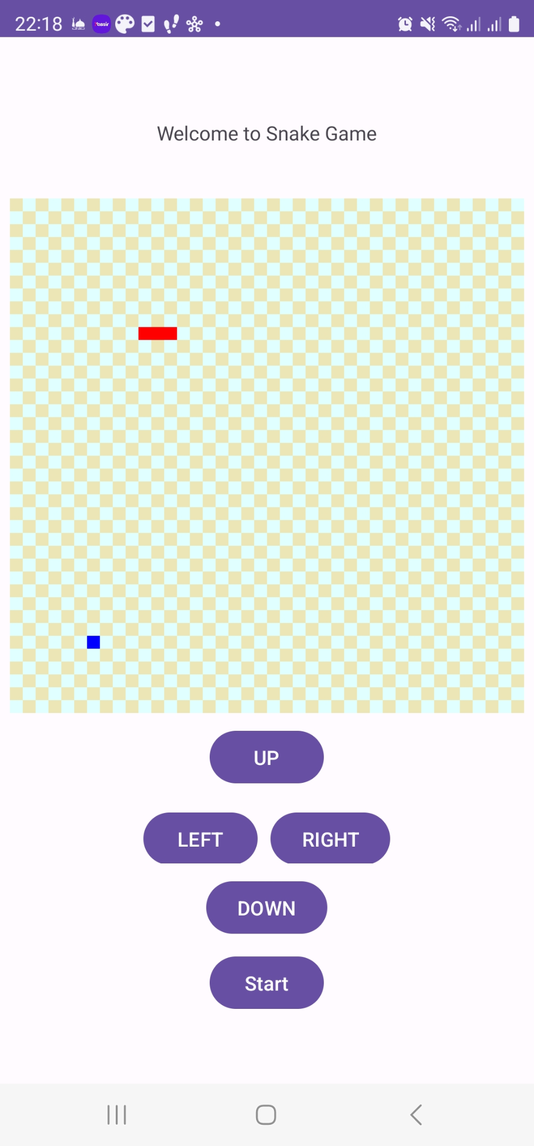
Recap for Week 4: Navigation, UIs and Threads
Snake Game : Plenty of UX/Usability Errors :
Why show the direction button when The game has not started yet ?

Slide 5
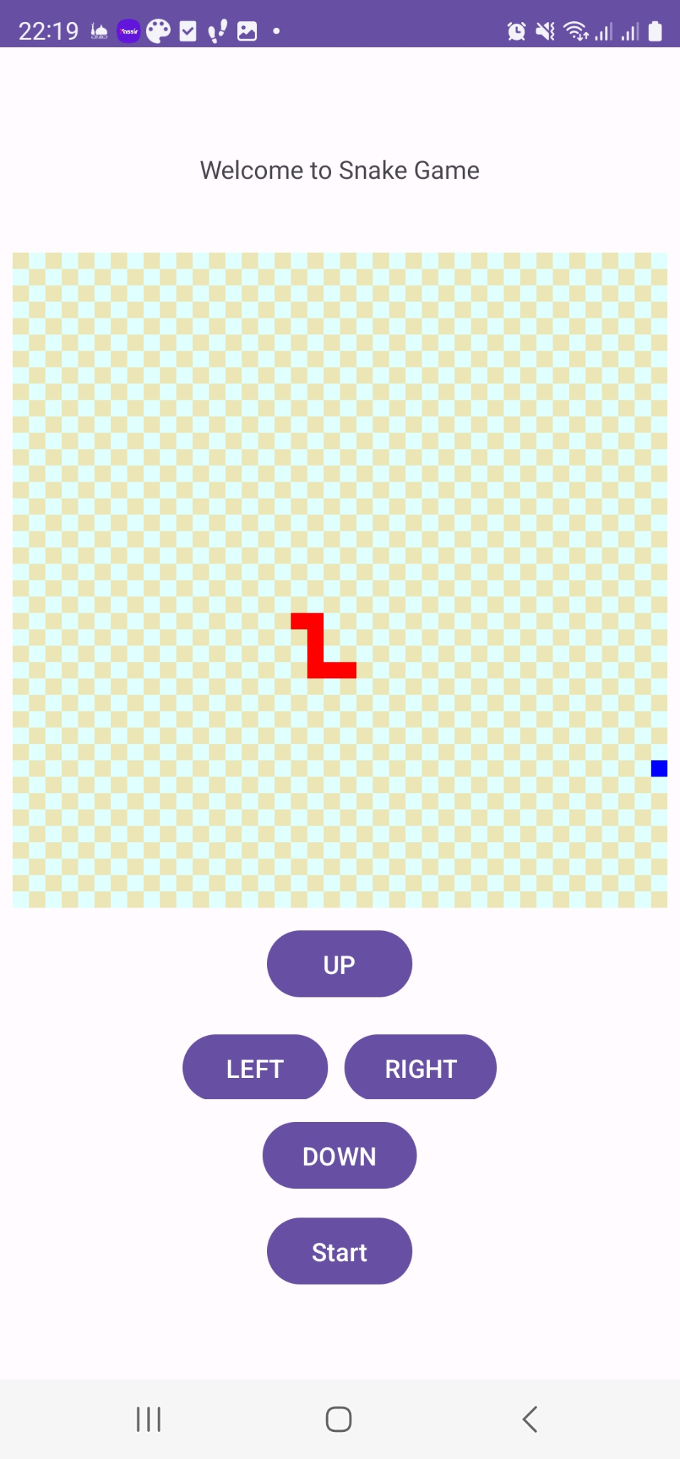
Recap for Week 4: Navigation, UIs and Threads
Snake Game : Problem Solving Exercise
How to eat food ?
How to create an AI-Competing snake playing Against the human player ?
This is why you can employ what you have learnt in AI, OR, Optimisation…

Slide 6
Asynchronous Programming : Coroutines
Asynchronous programming is a technique used to perform long-running tasks without blocking the main thread of an application.
When the main thread is busy rendering the user interface and handling user input, you cannot invoke a function to call the network which would block the execution of the main thread causing the UI to freeze
Traditionally, asynchronous tasks have been implemented using callbacks, which can make the code complex and hard to understand.

Slide 7
Asynchronous Tasks & Coroutines
Coroutines
A coroutine is a concurrency design pattern that you can use on Android to simplify code that executes asynchronously
Coroutines are lightweight threads:
Creating coroutines doesn’t allocate new threads. Instead, they use predefined thread pools and smart scheduling for the purpose of which task to execute next.

Slide 8
Asynchronous Tasks & Coroutines
suspend fun doSomethingUsefulOne(): Int { delay(1000L) return 13 } suspend fun doSomethingUsefulTwo(): Int { delay(1000L) return 29 }
fun main() = runBlocking<Unit> {
val time = measureTimeMillis {
val one = doSomethingUsefulOne()
val two = doSomethingUsefulTwo()
println("The answer is ${one + two}")
}
println("Completed in $time ms")
}
Terminologies for Coroutines
Suspending Functions :
Functions that can be suspended or paused and resumed later without blocking the main thread .
Example :
The answer is 42

Slide 9
Asynchronous Tasks & Coroutines
suspend fun doSomethingUsefulOne(): Int { delay(1000L) return 13 } suspend fun doSomethingUsefulTwo(): Int { delay(1000L) return 29 }
fun main() = runBlocking<Unit> {
val time = measureTimeMillis {
val one = doSomethingUsefulOne()
val two = doSomethingUsefulTwo()
println("The answer is ${one + two}")
}
println("Completed in $time ms")
}
Terminologies for Coroutines
Suspending Functions :
Functions that can be suspended or paused and resumed later .
Example :
Suspend functions are only allowed to be called from a coroutine or another suspend function
The answer is 42

Slide 10
Asynchronous Tasks & Coroutines
Terminologies for Coroutines
Coroutine Dispatchers :
Help coroutines in deciding which thread to use for executing the job.
There are four major types of dispatchers :
Main Dispatcher : for the UI
IO Dispatcher : for all jobs related to reading/writing files or networking
Default Dispatcher : execute coroutines on a shared background thread
Unconfined Dispatcher : will use the current active thread.

Slide 11
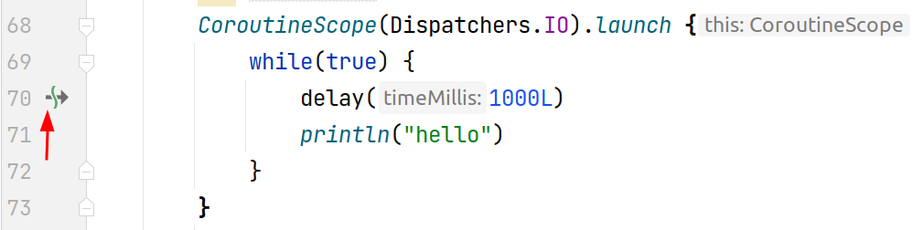
Asynchronous Tasks & Coroutines
Terminologies for Coroutines
Launching Coroutines :
Coroutines are started using either:
CoroutineScope.METHOD_NAME(Dispather_TYPE)

Slide 12
Asynchronous Tasks & Coroutines
Terminologies for Coroutines
Launching Coroutines :
METHOD_NAME starting coroutines :
launch : creates and starts a new coroutine. It returns a Job object that can be used to manage the lifecycle of the coroutine. But does not return data …
runBlock : blocks the current thread and runs a new coroutine until it completes. Used for testing.
async : creates and starts a new coroutine that runs asynchronously. It returns a Deferred (future) object to store data

Slide 13
Asynchronous Tasks & Coroutines
AutoIncrementer App using Coroutines
Launching Coroutines :
private fun startCounting(){
var tx_counter=findViewById<TextView>(R.id.tx_counter)
var handler = Handler(Looper.getMainLooper())
val runnable =object : Runnable{
override fun run() {
if (!is_running) return
increment = increment + 1
tx_counter.setText("" + increment)
println("running the thread.......")
handler.postDelayed(this, 1000)
}
}
handler.postDelayed(runnable, 1000)
}

Slide 14
Asynchronous Tasks & Coroutines
What happens ?
AutoIncrementer App using Coroutines
Launching Coroutines :
private fun startCounting(){
var tx_counter=findViewById<TextView>(R.id.tx_counter)
var handler = Handler(Looper.getMainLooper())
val runnable =object : Runnable{
override fun run() {
while(is_running) {
increment = increment + 1
tx_counter.setText("" + increment)
println("running the thread.......")
Thread.sleep(1000)
}
}
}
handler.postDelayed(runnable, 1000)
}

Slide 15
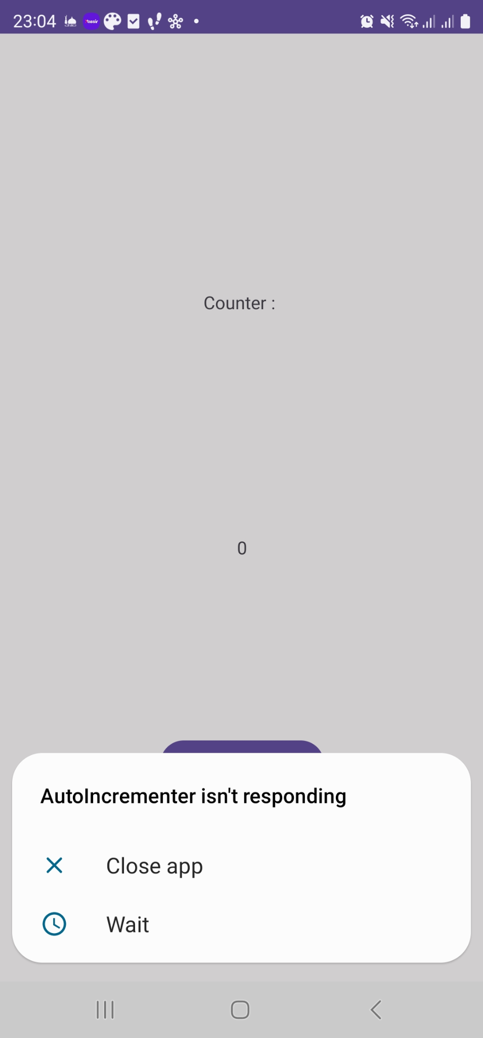
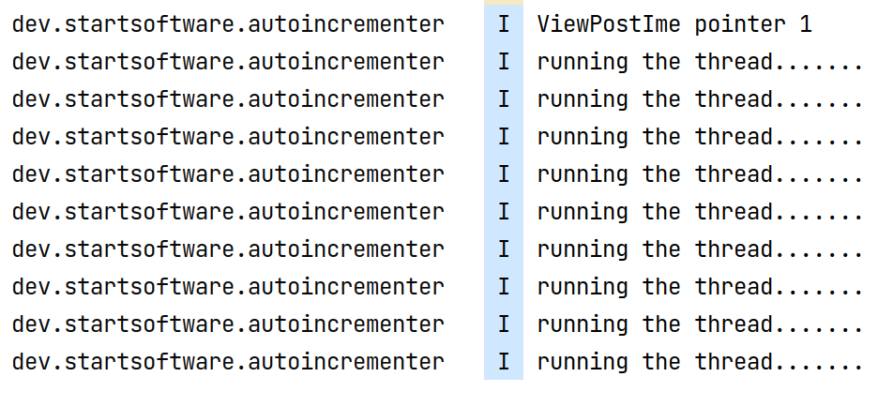
Asynchronous Tasks & Coroutines
Runs, prints to the console, not updating the UI , the app is crashing…
AutoIncrementer App using Coroutines
Launching Coroutines :
private fun startCounting(){
var tx_counter=findViewById<TextView>(R.id.tx_counter)
var handler = Handler(Looper.getMainLooper())
val runnable =object : Runnable{
override fun run() {
while(is_running) {
increment = increment + 1
tx_counter.setText("" + increment)
println("running the thread.......")
Thread.sleep(1000)
}
}
}
handler.postDelayed(runnable, 1000)
}

Slide 16

Asynchronous Tasks & Coroutines
AutoIncrementer App using Coroutines
Update the build.gradle File :
Make sure you sync the gradle
dependencies {
...
implementation 'org.jetbrains.kotlinx:kotlinx-coroutines-core:1.4.2'
implementation 'org.jetbrains.kotlinx:kotlinx-coroutines-android:1.4.2'
}

Slide 17
Asynchronous Tasks & Coroutines
AutoIncrementer App using Coroutines
Launching Coroutines :
private fun startCounting(){
var tx_counter=findViewById<TextView>(R.id.tx_counter)
CoroutineScope(Dispatchers.IO).launch {
while(is_running) {
increment = increment + 1
tx_counter.setText("" + increment)
println("running the thread.......")
delay(1000)
}
}
}
Does it work ?

Slide 18
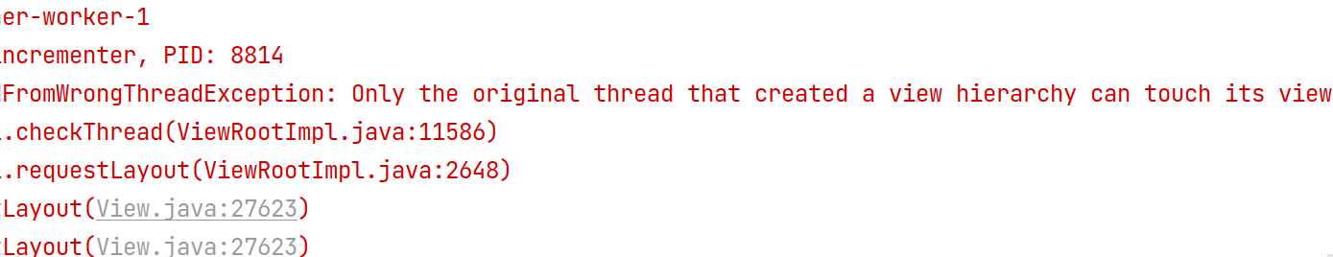
Asynchronous Tasks & Coroutines
AutoIncrementer App using Coroutines
Launching Coroutines :
private fun startCounting(){
var tx_counter=findViewById<TextView>(R.id.tx_counter)
CoroutineScope(Dispatchers.IO).launch {
while(is_running) {
increment = increment + 1
tx_counter.setText("" + increment)
println("running the thread.......")
delay(1000)
}
}
}
Does it work ? NO

Slide 19
Asynchronous Tasks & Coroutines
AutoIncrementer App using Coroutines
Launching Coroutines :
private fun startCounting(){
var tx_counter=findViewById<TextView>(R.id.tx_counter)
CoroutineScope(Dispatchers.IO).launch {
while(is_running) {
increment = increment + 1
withContext(Dispatchers.Main) {
tx_counter.setText("" + increment)
}
println("running the thread.......")
delay(1000)
}
}
}

Slide 20
Asynchronous Tasks & Coroutines
AutoIncrementer App using Coroutines
Launching Coroutines :
Consider always the use of Progressbar or loading… when necessary…
private fun startCounting(){
var tx_counter=findViewById<TextView>(R.id.tx_counter)
CoroutineScope(Dispatchers.IO).launch {
while(is_running) {
increment = increment + 1
withContext(Dispatchers.Main) {
tx_counter.setText("" + increment)
}
println("running the thread.......")
delay(1000)
}
}
}

Slide 21
Data Persistence Ways of storing data
Data can be stored for mobile apps using :
Shared Preferences
Local Databases
As Files in the filesystem
Cloud Services :
Firebase ( To be seen fully with Flutter )
AWS + …

Slide 22
Data Persistence Shared Preferences
Shared Preferences :
It is a way to store primitive data in the form key:value using the class SharedPreferences
It is recommended to use it for small data
Android keeps Shared Preferences in XML file format. The file is called “shared_prefs” that can be accessed at: Data/data/{application package}
Examples of data that can be stored inside the shared preferences include App or user settings.

Slide 23
Data Persistence Shared Preferences
Creating SharedPreference File
Need to specify a given file name in addition to the security mode
The editor Object must be initialized to write data.
var PREFS_NAME="DATA_INCREMENT"
class MainActivity : AppCompatActivity() {
override fun onCreate(savedInstanceState: Bundle?) {
super.onCreate(savedInstanceState)
setContentView(R.layout.activity_main)
var sharedpreferences = getSharedPreferences(PREFS_NAME, Context.MODE_PRIVATE)
val editor: SharedPreferences.Editor = sharedpreferences.edit()

Slide 24
Data Persistence Shared Preferences
Creating SharedPreference File
Access Levels of SharedPreferences :
There are three levels of access for shared data :
Activity-Level : getPreferences()
Application-Level : getSharedPreferences() ( Recommended to use )
Android-Level : getDefaultSharedPreferences()
var sharedpreferences = getSharedPreferences(PREFS_NAME, Context.MODE_PRIVATE)

Slide 25
Data Persistence Shared Preferences
Creating SharedPreference File
Security and Private of the sharedPreference File :
MODE_PRIVATE ( Default)
MODE_WORLD_READABLE
MODE_WORLD_WRITEABLE
.
MODE_WORLD_* are deprecated, use other ways to share data
var sharedpreferences = getSharedPreferences(PREFS_NAME, Context.MODE_PRIVATE)

Slide 26
Data Persistence Shared Preferences
Storing Data using Shared Preferences :
To store data in the format : key - value
Commit ( or apply() ) must be called to save the data.
editor.putInt("increment",increment) editor.putFloat("price",floatVar)
editor.putString("Today","Monday")
editor.commit()

Slide 27
Data Persistence Shared Preferences
Storing Data using Shared Preferences :
To remove a variable from the sharedPreference storage:
To remove all data :
editor.remove("increment")
editor.commit()
editor.clear()
editor.commit()

Slide 28
Data Persistence Shared Preferences
Getting Data using Shared Preferences :
The getter method of the sharePreferences are used depending on the type : getInt , getString, getFloat…
var sharedpreferences = getSharedPreferences(PREFS_NAME, Context.MODE_PRIVATE)
increment=sharedpreferences.getInt("increment",0)
var day=sharedpreferences.getString("Today","Sunday")

Slide 29
Data Persistence Shared Preferences
Example : Auto Incrementing App
Where to place the code for :
Initializing the Shared preferences ?
Saving the data ? After each thread invocation ?
Loading the data ?

Slide 30
Data Persistence Shared Preferences
Does it work ?
Example : Auto Incrementing App
var sharedpreferences : SharedPreferences = getSharedPreferences(PREFS_NAME, Context.MODE_PRIVATE)
var editor: SharedPreferences.Editor = sharedpreferences
override fun onCreate(savedInstanceState: Bundle?) {
super.onCreate(savedInstanceState)
setContentView(R.layout.activity_main)
increment=sharedpreferences.getInt("increment",0)
var day=sharedpreferences.getString("Today","Sunday")
findViewById<Button>(R.id.tx_counter).text=""+increment

Slide 31
Data Persistence Shared Preferences
Example : Auto Incrementing App
lateinit var sharedpreferences : SharedPreferences
lateinit var editor: SharedPreferences.Editor
override fun onCreate(savedInstanceState: Bundle?) {
super.onCreate(savedInstanceState)
setContentView(R.layout.activity_main)
sharedpreferences = getSharedPreferences(PREFS_NAME, Context.MODE_PRIVATE)
editor = sharedpreferences.edit()
increment=sharedpreferences.getInt("increment",0)
var day=sharedpreferences.getString("Today","Sunday")
findViewById<Button>(R.id.tx_counter).text=""+increment

Slide 32
Data Persistence Shared Preferences
Example : Auto Incrementing App
When or when to save the data ?

Slide 33
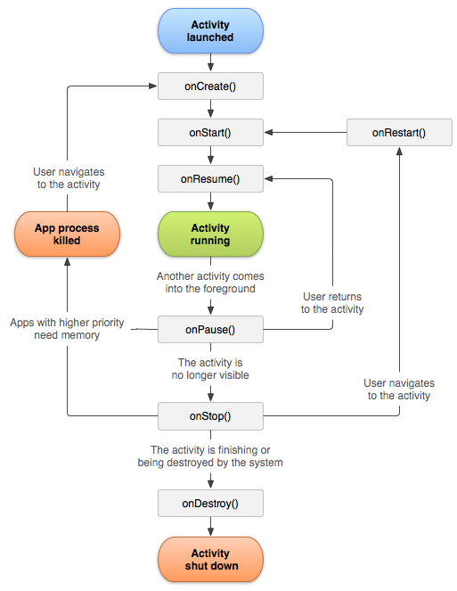
Data Persistence Shared Preferences
Example : Auto Incrementing App
When or Where to save the data ?
Lifecycle of the Activity

Slide 34
Data Persistence Shared Preferences
Example : Auto Incrementing App
The lifecycle functions can be used to inject the code for saving data :
override fun onStop() {
super.onStop()
var sharedpreferences = getSharedPreferences(PREFS_NAME, Context.MODE_PRIVATE)
var editor: SharedPreferences.Editor = sharedpreferences.edit()
editor.putInt("increment",increment)
editor.putString("Today","Monday")
editor.commit()
}

Slide 35
Data Persistence Relational Embedded Databases
Relational Databases : SQLite:
SQLite is a well-regarded SQL-based relational database management system (RDBMS). It is
Open source
Standards-compliant, implementing most of the SQL standard
Lightweight
Single-tier
ACID compliant

Slide 36
Data Persistence Relational Embedded Databases
Relational Databases : SQLite:
SQLite is implemented as a compact C library that’s included as part of the Android software stack
Each SQLite database is an integrated part of the application that created it. This reduces external dependencies, minimizes latency, and simplifies transaction locking and synchronization.
Android databases are stored in the /data/data/<package_name>/databases folder on your device (or emulator).

Slide 37
Data Persistence Relational Embedded Databases
SQL Reminder : Creating Tables
CREATE TABLE IF NOT EXISTS expenses (
expense_id INTEGER PRIMARY KEY AUTOINCREMENT,
name TEXT NOT NULL,
price REAL NOT NULL,
date REAL NOT NULL,
image BLOB NULL
);

Slide 38
Data Persistence Relational Embedded Databases
SQL Reminder : Creating Tables
Data Types :
VARCHAR(N)
TEXT
INT
LONG
DATE
ENUM ..

Slide 39
Data Persistence Relational Embedded Databases
SQL Reminder : Searching and Retrieving Data
SELECT table_name.column1,...FROM table_name WHERE table_name.column1>1
SELECT table_name.column1,...FROM table_name , table_two WHERE
table_name.foreign_id=table_two.id AND
table_name.column1>1
SELECT table_name.column1,...FROM table_name LEFT JOIN table_two ON table_name.foreign_id=table_two.id WHERE table_name.column1>1 ORDER BY table_name.column DESC LIMIT 10

Slide 40
Data Persistence Relational Embedded Databases
SQL Reminder : Updating Data
UPDATE table_name SET
column_name1=’VALUE’, column_name2=’another VALUE’,
WHERE
column_name5=’some value’

Slide 41
Data Persistence Relational Embedded Databases
Example : Integrating the database for the Expense Mobile App
Adding Permission inside the AndroidManifest.xml File
<uses-permission android:name="android.permission.READ_EXTERNAL_STORAGE" />

Slide 42
Data Persistence Relational Embedded Databases
Example : Integrating the database for the Expense Mobile App
DB Helper
package dev.startsoftware.simpleexpenseappnodb
import android.content.Context
import android.database.sqlite.SQLiteDatabase
import android.database.sqlite.SQLiteOpenHelper
class DBHelper(context: Context, factory: SQLiteDatabase.CursorFactory?) :
SQLiteOpenHelper(context, DATABASE_NAME, factory, DATABASE_VERSION) {
companion object{
private val DATABASE_NAME = "EXPENSE_APP"
private val DATABASE_VERSION = 1
}
}

Slide 43
Data Persistence Relational Embedded Databases
package dev.startsoftware.simpleexpenseappnodb
import android.content.Context
import android.database.sqlite.SQLiteDatabase
import android.database.sqlite.SQLiteOpenHelper
class DBHelper(context: Context, factory: SQLiteDatabase.CursorFactory?) :
SQLiteOpenHelper(context, DATABASE_NAME, factory, DATABASE_VERSION) {
companion object{
private val DATABASE_NAME = "EXPENSE_APP"
private val DATABASE_VERSION = 1
}
override fun onCreate(db: SQLiteDatabase) {
val query = ("""
SQL HERE
""".trimIndent())
db.execSQL(query)
}
override fun onUpgrade(db: SQLiteDatabase, p1: Int, p2: Int) {
db.execSQL("DROP TABLE IF EXISTS expenses");
db.execSQL("or instead, alter some data...");
onCreate(db)
}
}
Example : Integrating the database for the Expense Mobile App
DB Helper

Slide 44
Data Persistence Relational Embedded Databases
package dev.startsoftware.simpleexpenseappnodb
import android.content.Context
import android.database.sqlite.SQLiteDatabase
import android.database.sqlite.SQLiteOpenHelper
class DBHelper(context: Context, factory: SQLiteDatabase.CursorFactory?) :
SQLiteOpenHelper(context, DATABASE_NAME, factory, DATABASE_VERSION) {
companion object{
private val DATABASE_NAME = "EXPENSE_APP"
private val DATABASE_VERSION = 1
}
override fun onCreate(db: SQLiteDatabase) {
val query = ("""
CREATE TABLE expenses IF NOT EXISTS (
expense_id INTEGER PRIMARY KEY AUTOINCREMENT,
name TEXT,
price REAL,
image BLOB
)
""".trimIndent())
db.execSQL(query)
}
override fun onUpgrade(db: SQLiteDatabase, p1: Int, p2: Int) {
db.execSQL("DROP TABLE IF EXISTS expenses");
db.execSQL("or instead, alter some data...");
onCreate(db)
}
}
Example : Integrating the database for the Expense Mobile App
DB Helper

Slide 45
Data Persistence Relational Embedded Databases
Example : Integrating the database for the Expense Mobile App
Initialize the DBHelper Instance
class MainActivity : AppCompatActivity() {
companion object {
var data = Vector<Expense>()
}
class MainActivity : AppCompatActivity() {
companion object {
lateinit var db: DBHelper ;
}
var data = Vector<Expense>()
override fun onCreate(savedInstanceState: Bundle?) {
super.onCreate(savedInstanceState)
setContentView(R.layout.activity_main)
db = DBHelper(this, null)

Slide 46
Data Persistence Relational Embedded Databases
Example : Integrating the database for the Expense Mobile App
Inserting an Expense
Inside the Expense Activity
class NewExpense : AppCompatActivity() {
override fun onCreate(savedInstanceState: Bundle?) {
super.onCreate(savedInstanceState)
bt_add.setOnClickListener {
...
MainActivity.db.insertExpense(Expense(nameVal,dateVal,priceVal))
...
this.setResult(RESULT_OK, intent)
this.finish()
}

Slide 47
Data Persistence Relational Embedded Databases
Example : Integrating the database for the Expense Mobile App
Inserting an Expense
Inside the DBHelper Class :
class DBHelper(context: Context, factory: SQLiteDatabase.CursorFactory?) … {
fun insertExpense(expense : Expense) : Boolean{
try {
val db = this.writableDatabase
val values = ContentValues()
values.put("name",expense.name)
values.put("price",expense.price)
values.put("date",expense.date)
db.insert("expenses", null, values)
}catch (e: Exception){ return false }
return true
}

Slide 48
Data Persistence Relational Embedded Databases
Example : Integrating the database for the Expense Mobile App
Retrieving all Expenses
Inside the Main Activity :
private fun drawExpense(){
var lv_expenses=findViewById<ListView>(R.id.lv_expenses)
var data = db.getExpenses()
lv_expenses.adapter=ListExpenseAdapter(this,data)
lv_expenses.refreshDrawableState()
}

Slide 49
Data Persistence Relational Embedded Databases
Example : Integrating the database for the Expense Mobile App
Retrieving all Expenses
Inside the DBHelper Class:
fun getExpenses() : Vector<Expense> {
var data=Vector<Expense>()
val db = this.readableDatabase
val res = db.rawQuery("select * from expenses", null)
res.moveToFirst()
while (res.isAfterLast == false) {
data.add(Expense(
res.getString(res.getColumnIndex("name").toInt()),
res.getString(res.getColumnIndex("date").toInt()),
res.getDouble(res.getColumnIndex("price").toInt()),
))
res.moveToNext()
}
return data
}

Slide 50
Data Persistence Relational Embedded Databases
Example : Integrating the database for the Expense Mobile App
Retrieving all Expenses
Inside the Main Activity :
class MainActivity : AppCompatActivity() {
companion object {
lateinit var db: DBHelper ;
}
override fun onCreate(savedInstanceState: Bundle?) {
super.onCreate(savedInstanceState)
setContentView(R.layout.activity_main)
db = DBHelper(this, null)
drawExpense()

Slide 51
Data Persistence Relational Embedded Databases
Example : Integrating the database for the Expense Mobile App
How to update when DB is used ? Previous code using Vector :
Main Activity :
EditExpense Activity :
lv_expenses.setOnItemClickListener { parent, view, position, id ->
val intent = Intent(this, EditExpense::class.java)
intent.putExtra("expense_index", position)
launchActivityNewExpense.launch(intent)
}
var expense : Expense?=null
if (extras != null) {
position_id = extras.getInt("position_id")
expense=MainActivity.data.get(position_id) as Expense

Slide 52
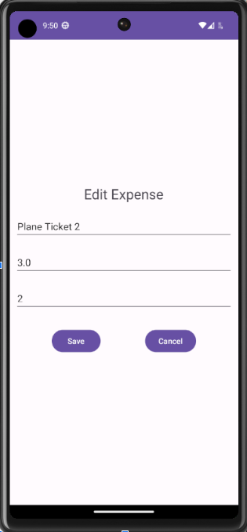
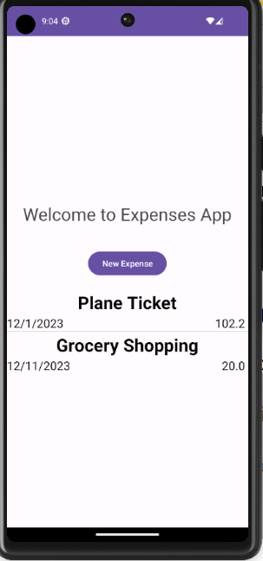
Data Persistence Relational Embedded Databases
Example : Integrating the database for the Expense Mobile App
Updating an Expense :
Intent : what data to pass ? DB ID ?

Slide 53
Data Persistence Relational Embedded Databases
Example : Integrating the database for the Expense Mobile App
Updating an Expense
The ListView or UI component is passing the p Activity :
lv_expenses.setOnItemClickListener { parent, view, position, id ->
val intent = Intent(this, EditExpense::class.java)
intent.putExtra("expense_index", position)
launchActivityNewExpense.launch(intent)
}
lv_expenses.setOnItemClickListener { parent, view, position, id ->
val intent = Intent(this, EditExpense::class.java) var expense_db_id = ...
intent.putExtra("expense_db_id", expense_db_id)
launchActivityNewExpense.launch(intent)
}

Slide 54
Data Persistence Relational Embedded Databases
Example : Integrating the database for the Expense Mobile App
Updating an Expense
Adding db_id into the Expense Class
Default value is zero
class Expense(var name:String,var date:String,var price:Double,var db_id:Int=0)

Slide 55
Data Persistence Relational Embedded Databases
Example : Integrating the database for the Expense Mobile App
Updating an Expense
When retrieving all expenses inside the DBHelper
fun getExpenses() : Vector<Expense> {
var data=Vector<Expense>()
val db = this.readableDatabase
val res = db.rawQuery("select * from expenses", null)
res.moveToFirst()
while (res.isAfterLast == false) {
data.add(Expense(
res.getString(res.getColumnIndex("name").toInt()),
res.getString(res.getColumnIndex("date").toInt()),
res.getDouble(res.getColumnIndex("price").toInt()),
db_id=res.getInt(res.getColumnIndex("expense_id").toInt())
))
res.moveToNext()
}
return data

Slide 56
Data Persistence Relational Embedded Databases
Example : Integrating the database for the Expense Mobile App
Updating an Expense
Inside the Main Activity, DB_ID of the Expense is sent with the intent
lv_expenses.setOnItemClickListener { parent, view, position, id ->
val intent = Intent(this, EditExpense::class.java)
var expense_db_id=data[position].db_id
intent.putExtra("expense_db_id", expense_db_id)
launchActivityNewExpense.launch(intent)
}

Slide 57
Data Persistence Relational Embedded Databases
Example : Integrating the database for the Expense Mobile App
Updating an Expense
Inside the EditExpense Activity
if (extras != null) {
position_id = extras.getInt("position_id")
expense=MainActivity.data.get(position_id) as Expense
if (extras != null) {
expense_db_id = extras.getInt("expense_db_id")
expense=MainActivity.db.getExpeneById(expense_db_id)

Slide 58
Data Persistence Relational Embedded Databases
Example : Integrating the database for the Expense Mobile App
Updating an Expense
Inside the DBHelper Class:
fun getExpeneById(id:Int) : Expense?{
var expense:Expense?=null
val db = this.readableDatabase
val res = db.rawQuery(
"select * from expenses where expense_id=?",
arrayOf(""+id)
)
res.moveToFirst()
if(res.isAfterLast() == false) {
expense=Expense(
res.getString(res.getColumnIndex("name").toInt()),
res.getString(res.getColumnIndex("date").toInt()),
res.getDouble(res.getColumnIndex("price").toInt()),
db_id=res.getInt(res.getColumnIndex("expense_id").toInt())
)
}
return expense
}

Slide 59
Data Persistence Relational Embedded Databases
Example : Integrating the database for the Expense Mobile App
Updating an Expense
This is the old code when clicking the button save
bt_save.setOnClickListener {
expense?.name=findViewById<EditText>(R.id.tx_description).text.toString()
expense?.date=findViewById<EditText>(R.id.tx_date).text.toString()
expense?.price=findViewById<EditText>(R.id.tx_amount).text.toString().toDouble()
val intent = Intent()
this.setResult(RESULT_OK, intent)
this.finish()
}
We have to save to a database

Slide 60
Data Persistence Relational Embedded Databases
Example : Integrating the database for the Expense Mobile App
Updating an Expense
This is the old code when clicking the button save
bt_save.setOnClickListener {
expense?.name=findViewById<EditText>(R.id.tx_description).text.toString()
expense?.date=findViewById<EditText>(R.id.tx_date).text.toString()
expense?.price=findViewById<EditText>(R.id.tx_amount).text.toString().toDouble() MainActivity.db.saveExpense(expense)
val intent = Intent()
this.setResult(RESULT_OK, intent)
this.finish()
}

Slide 61
Data Persistence Relational Embedded Databases
Example : Integrating the database for the Expense Mobile App
Updating an Expense
DBHelper Class
fun saveExpense(expense: Expense): Boolean{
try {
val db = this.writableDatabase
val values = ContentValues()
values.put("name",expense.name)
values.put("price",expense.price)
values.put("date",expense.date)
db.update(
"expenses",
values,
"expense_id=?",
arrayOf(""+expense.db_id));
}catch (e: Exception){
return false
}
return true
}

Slide 62
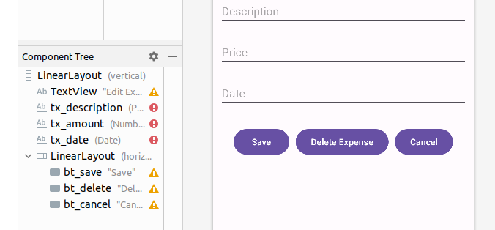
Data Persistence Relational Embedded Databases
Example : Integrating the database for the Expense Mobile App
Deleting an Expense
Inside the XML for the EditExpense
Add a Button bt_delete

Slide 63
Data Persistence Relational Embedded Databases
Example : Integrating the database for the Expense Mobile App
Delete an Expense
EditExpense Activity
var bt_delete=findViewById<Button>(R.id.bt_delete)
bt_delete.setOnClickListener {
MainActivity.db.deleteExpenseById((expense as Expense).db_id )
val intent = Intent()
this.setResult(RESULT_OK, intent)
Toast.makeText(this, "Expense is deleted successfully", Toast.LENGTH_SHORT).show()
this.finish()
}

Slide 64
Data Persistence Relational Embedded Databases
Example : Integrating the database for the Expense Mobile App
Delete an Expense
DBHelper Class :
fun deleteExpenseById(id:Int){
val db = this.writableDatabase
db.delete("expenses",
"expense_id = ? ",
arrayOf(""+id));
}

Slide 65
Data Persistence Relational Embedded Databases
For Simplicity : I am dumping all the functions related to getting Expenses Data into the DBHelper
What happens if we have other entities : Categories ? Users ? … You need to create a utility class for each entity and write the associated mapping function to conduct data logic.
Example : Integrating the database for the Expense Mobile App
Delete an Expense
DBHelper Class :
fun deleteExpenseById(id:Int){
val db = this.writableDatabase
db.delete("expenses",
"expense_id = ? ",
arrayOf(""+id));
}

Slide 66
Data Persistence Relational Embedded Databases
Tedious Programming Style
As a result, whenever you wish to store data in an SQLite table, you must first extract the data stored as variables within each object, and convert them into a row of values according to the columns of your table (using Content Values).
Similarly, when extracting data from the table, you receive one or more rows of values (as a Cursor), which must be translated into one or more objects.

Slide 67
Data Persistence Relational Embedded Databases
Object Relational Mapping : ORM
It is a technique where relational database rows are accessed inside a programming language as objects where each row is visualized as an object.
Column for a row, is the instance variable for the corresponding object.
Upon modifying the value for an instance variable, the mapped column in the database table for the corresponding row is updated automatically.
Creating an object will insert a row automatically into the table.
In short, Rare use of SQL whilst OOP is used instead.

Slide 68
Data Persistence Relational Embedded Databases
ROOM as an ORM over SQLite
Room is a persistence library that simplifies the process of adding a structured SQL database to your app.
Room provides an abstraction layer as an ORM over an SQLite backend, making it easier to define and access a database for your app’s structured data, while still offering the full power of SQLite.

Slide 69
Data Persistence Relational Embedded Databases
ROOM as an ORM over SQLite
The Room persistence model requires you to define three components:
Entity : One or more classes, annotated with the @Entity annotation, which define the structure of a database table that will be used to store instances of the annotated class.
Data Access Object (Dao)—A class annotated with the @Dao annotation that will define the methods used to modify or query the database.
Room Database—An abstract class annotated with the @Database annotation that extends RoomDatabase. This class is the main access point for the underlying SQLite connection

Slide 70
Data Persistence Relational Embedded Databases
ROOM as an ORM over SQLite
Adding the dependencies :
plugins {
id 'com.android.application'
id 'org.jetbrains.kotlin.android'
id 'kotlin-kapt'
}
…

Slide 71
Data Persistence Relational Embedded Databases
dependencies {
...
def room_version = "2.3.0"
implementation "androidx.room:room-runtime:$room_version"
kapt "androidx.room:room-compiler:$room_version"
annotationProcessor "androidx.room:room-compiler:$room_version"
implementation "androidx.room:room-ktx:$room_version"
implementation 'org.jetbrains.kotlinx:kotlinx-coroutines-core:1.4.2'
implementation 'org.jetbrains.kotlinx:kotlinx-coroutines-android:1.4.2'
def lifecycle_version = "2.3.1"
implementation "androidx.lifecycle:lifecycle-runtime-ktx:$lifecycle_version"
}
ROOM as an ORM over SQLite
Adding the dependencies :

Slide 72
Data Persistence Relational Embedded Databases
ROOM as an ORM over SQLite
Creating the Entity Data Class = Creating the Table
ExpenseEntity.kt
import androidx.room.ColumnInfo
import androidx.room.Entity
import androidx.room.PrimaryKey
@Entity(tableName = "expenses")
data class ExpenseEntity(
@PrimaryKey(autoGenerate = true)
var expense_id: Int,
var name: String,
var date: String,
var price: Double,
)

Slide 73
Data Persistence Relational Embedded Databases
ROOM as an ORM over SQLite
Creating the DAO Interface ( Methods)
ExpenseDao.kt
@Dao
interface ExpenseDao {
@Insert
fun insertExpense(expense: ExpenseEntity)
@Query("SELECT * FROM expenses")
fun getAllExpenses(): List<ExpenseEntity>
@Update
fun updateExpense(expense:ExpenseEntity)
@Delete
fun deleteExpense(expense: ExpenseEntity)
}

Slide 74
Data Persistence Relational Embedded Databases
ROOM as an ORM over SQLite
Creating the Database Class ( Methods)
ExpenseDatabase.kt
We list all entitled + Methods to instances of the Dao of each table
@Database(entities = [ExpenseEntity::class], version = 1)
abstract class ExpenseDatabase : RoomDatabase() {
abstract fun expenseDao(): ExpenseDao
}

Slide 75
Data Persistence Relational Embedded Databases
ROOM as an ORM over SQLite
Creating the Database Class ( Methods)
Initializing the ROOM
override fun onCreate(savedInstanceState: Bundle?) {
super.onCreate(savedInstanceState)
setContentView(R.layout.activity_main)
db = Room.databaseBuilder(
applicationContext,
ExpenseDatabase::class.java, "simple_database_with_room_section1"
).build()
expenseDao = db.expenseDao()

Slide 76
Data Persistence Relational Embedded Databases
suspend fun coroutine_insertExpense():Unit{
var nameVal="Hello "+(0..100).random()
var dateVal="2023/11/22"
var priceVal=(0..100).random().toDouble()
var ret=expenseDao.insertExpense(
ExpenseEntity(0, nameVal, dateVal, priceVal)
)
return ret
}
suspend fun coroutine_listExpense():List<ExpenseEntity>{
var ret=expenseDao.getAllExpenses()
for (item in ret){
println("----->"+item.expense_id+" : "+item.name)
}
return ret
}
fun onResultInsertExpense(result: Unit) {}
ROOM as an ORM over SQLite
Creating the Database Class ( Methods)
Adding an Expense
var bt_add=findViewById<Button>(R.id.bt_add)
bt_add.setOnClickListener {
CoroutineScope(Dispatchers.IO).launch {
val result = coroutine_insertExpense()
onResultInsertExpense(result)
}
}

Slide 77
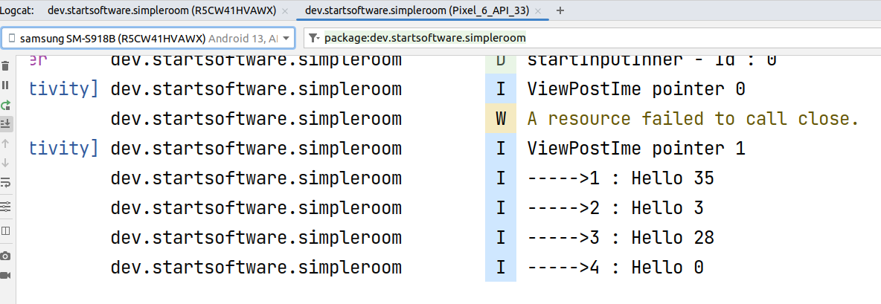
Data Persistence Relational Embedded Databases
ROOM as an ORM over SQLite
Creating Objects = Inserting Rows into the database Table

Slide 78
Using Internet Resources Accessing API/Web
Accessing the web shall be done using
Coroutines.
HTTP libraries :
Retrofit Library
Or simply :
val apiResponse = URL("yourUrl").readText()
<uses-permission android:name="android.permission.INTERNET" />
<uses-permission android:name="android.permission.ACCESS_NETWORK_STATE" />

Slide 79
Lecture Demo Apps
Auto Incrementer with Coroutines :
https://www.dropbox.com/scl/fo/60l8rzpjjt3hm2cx5jigx/h?rlkey=wwt0zk7zo429zeip5g2pimo98&dl=0
Showing and Hiding Progressbar using Coroutines to simulate heavy tasks
https://www.dropbox.com/scl/fo/iyopjlh4lrp11xlqniaew/h?rlkey=1sb17a81bgfav00uq07qjml4z&dl=0
Auto Incrementer with SharedPreferences and Coroutines
https://www.dropbox.com/scl/fo/mzoyipgyvnsovo95rxjsr/h?rlkey=nergvguxfuf9gsxmovphci754&dl=0
Expense App with a Database SQLite
https://www.dropbox.com/scl/fo/sqke9mr64ypmpqbry6kw5/h?rlkey=u4txf2hcy01hfhdvpuoe59oob&dl=0
Simple Hello World for using ROOM with SQLite.
https://www.dropbox.com/scl/fo/teke1td4p7m9yrwxpq3jv/h?rlkey=kubznbzh8u82r43aknhwidmxp&dl=0

Slide 80
Resources
https://www.sqlite.org/
https://kotlinlang.org/docs/coroutines-guide.html
https://developer.android.com/training/data-storage#pref
https://www.geeksforgeeks.org/android-sqlite-database-in-kotlin/
https://www.geeksforgeeks.org/json-parsing-in-android-using-volley-library-with-kotlin/
https://developer.android.com/kotlin/coroutines/coroutines-adv
https://www.fypsolutions.com/android/kotlin/kotlin-coroutines-for-network-call/
https://www.geeksforgeeks.org/kotlin-coroutines-on-android/
https://engineering.monstar-lab.com/en/post/2023/01/06/Introduction-to-Kotlin-Coroutines-for-Android/
https://developer.android.com/codelabs/kotlin-coroutines#0
https://github.com/android-java-kotlin/kotlin-coroutines-counter/blob/master/app/src/main/java/com/m7amdelbana/counter/MainActivity.kt

Slide 81
Next on Flutter
Creating Beautiful Screens
Creating Databases, Accessing the network,
Background Services
Using Firebase : Messaging, Storage..
Machine Learning Toolkits
Other Advanced Features.

